Slide 1
algorithm

Slide 2
find the root of the quadratic equation
exercise1
input a
input b
input c
compute x1 =(-b+(((b**b)
4*a*c***1/2))/2*a
print x₂

Slide 3
find the root of a cubic equation ax^{3 +bxc2 +cx +d =0}
input a
input b
input c
input d
a0=a/a
a1=b/a
a2=c/a
a3=d/a

Slide 4
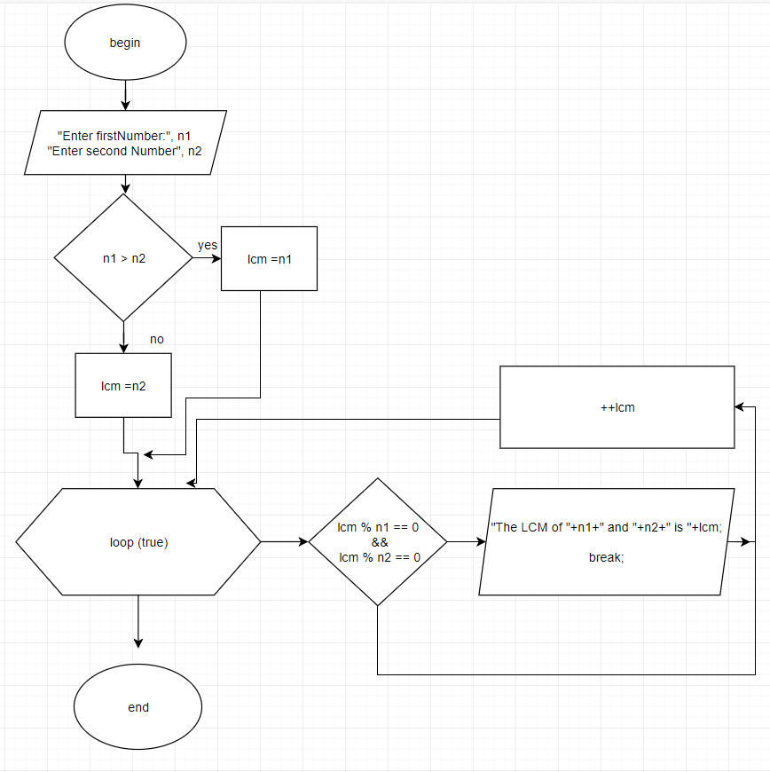
find ing the lcm of a number
PSUEDOCODE
START
enter first number
enter second number
n1>n2
lcm=n2
loop (true)
the lcm of ni and n2 is lcm
end

Slide 5
finding the gcd
define the function gcd a,b
if a==0 then return b else return gcd (b%a,a
input a and b
let c = gcd a,b
print c
end

Slide 6
largest of three numbers
psuedo code
input a
input b
input c
if a>b>c print a
if a,b,c THEN
PRINT ‘’THE LARGEST NUMBER IS ‘’ C

Slide 7
start
cubic equation
s=(R +((q**3) +9R**2**0.5))
input a
input b
input c
input d
a0=A/A
a1=B/A
a2=C/A
a3=D/A
q=((3*A2)_(A1**2))/9
print (x1,x2,x3)
stop

Slide 8
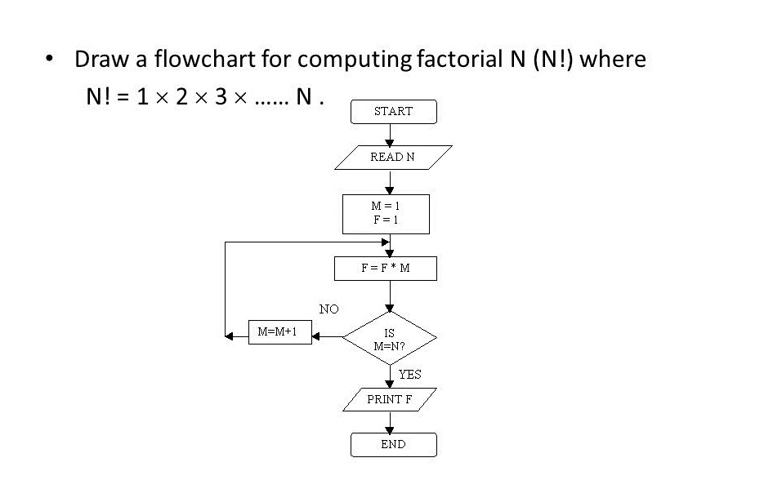
Find the factorials of number n (n!=1x2x3x...n)
start
declare n as an integer variable
initialize f=1
enter value for n
check whether n>0 if not then f=1
if yes then f=f>n
print the value for n
the value for f will be factorial of n

Slide 9
start
largest of the three numbers
input x
input y
input z
x<y<z
y>x>z
print largest number x
z>Y>X
print largest no y
print largest no z

Slide 10
start
quadratic equation
input a
input b
input c
compute first root
print x₁
end

